Slide 1
Session 1. Sudden Cardiac Death: Risk Stratification and Management
Sympathetic Neuromodulation for Management of VT
Chang Hee Kwo n, MD, PhD
Division of Cardiology, Konkuk University Medical Center

Slide 2
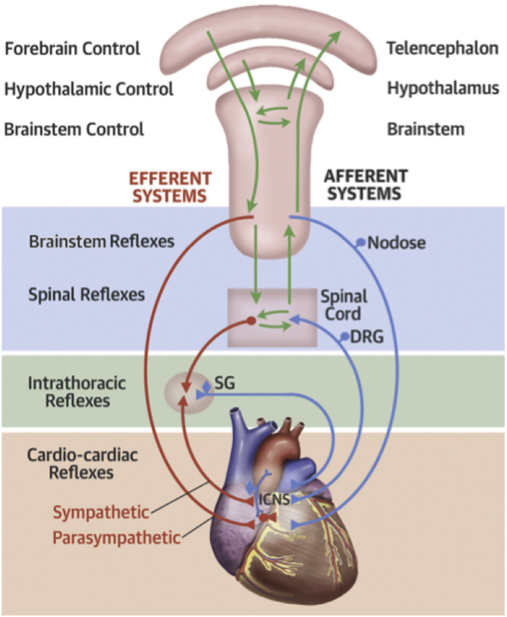
Cardiac autonomic control
Three main levels
The brain stem spinal cord
Intrathoracic extracardiac ganglia
The intrinsic cardiac nervous system
KONKUK UNIVERSITY MEDICAL CENTER
Zhu, C. et al. J Am Coll Cardiol EP. 2019;5(8):881–96
Notes:
Autonomic control of the heart consists of numerous, complex reﬂex loops that can be divided into 3 main levels: the brain stem spinal cord
(blue box); intrathoracic extracardiac ganglia (green box); and the intrinsic cardiac nervous system (tan box). The afferent limb (blue lines)
carries sensory information from the heart to higher levels, where it is processed by multiple components of the central nervous system (green
lines). The efferent limb (red lines) carries signals from higher levels down to the heart, to modulate cardiac function. Adapted with permission
from Goldberger JJ, Arora R, Buckley U, Shivkumar K. Autonomic nervous system dysfunction: JACC Focus Seminar. J Am Coll Cardiol
2019;73:1189–206. DRG ¼ dorsal root ganglion; ICNS ¼ intrinsic cardiac nervous system; SG ¼ stellate ganglion.

Slide 3
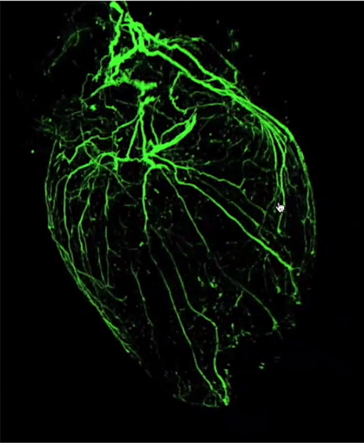
Background of cardiac neuromodulation
VT recurrence is not uncommon after ablation
Sympathetic nervous system plays a major role in initiation and maintenance of arrhythmias
Denervated heart is less arrhythmic and fibrillation is rare
Neuromodulation is potentially an adjunctive therapy to reduce VT burden
KONKUK UNIVERSITY MEDICAL CENTER
Courtesy of Harikrishna Tandri

Slide 4
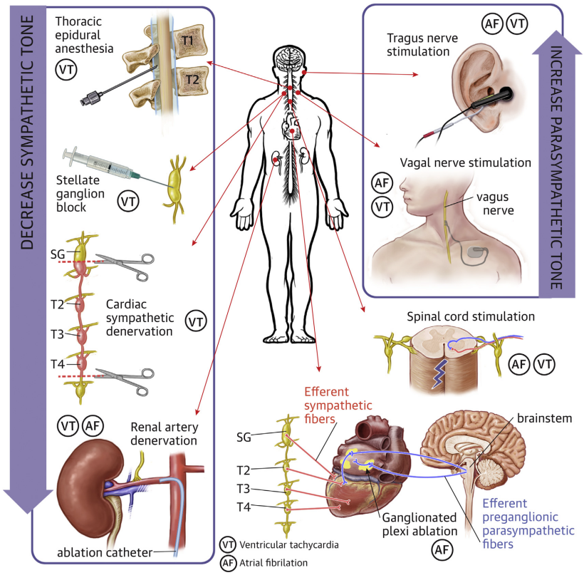
Neuromodulation for Arrhythmias
KONKUK UNIVERSITY MEDICAL CENTER
Zhu, C. et al. J Am Coll Cardiol EP. 2019;5(8):881–96
Notes:
Neuromodulatory therapies targeting sympathetic and parasympathetic pathways have been applied at multiple levels of the cardiac autonomic nervous system to treat
ventricular tachycardia (VT) and atrial ﬁbrillation (AF). Afferent nerve ﬁbers are omitted for simplicity. CSD ¼ cardiac sympathetic denervation; GP ¼ ganglionated plexi;
RDN ¼ renal artery denervation; SCS ¼ spinal cord stimulation; SGB ¼ stellate ganglion block; TEA ¼ thoracic epidural anesthesia; TNS ¼ tragus nerve stimulation;
VNS ¼ vagal nerve stimulation.

Slide 5
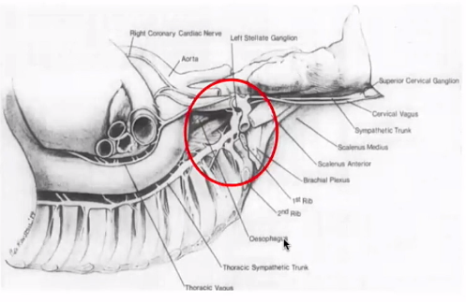
Stellate ganglion blockade
Anatomy of stellate ganglion
Cardiac nerves arise from the inferior cervical ganglia and T1, T2 thoracic ganglia
C8-T1 fuse to form the stellate ganglion
KONKUK UNIVERSITY MEDICAL CENTER

Slide 6
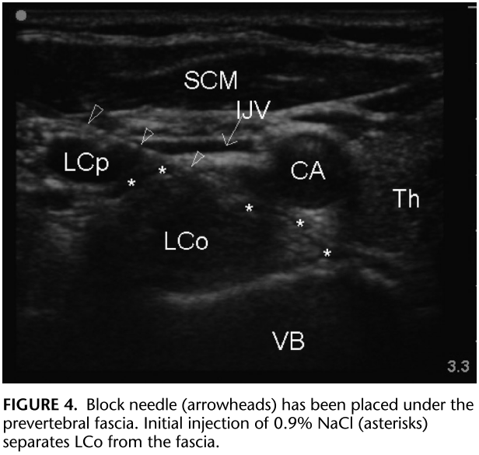
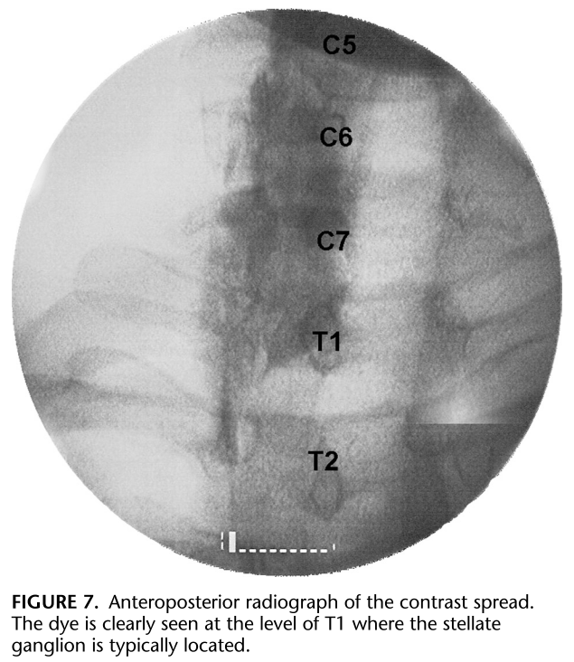
Stellate ganglion blockade
Ultrasound-Guided Stellate Ganglion Block at 2009
KONKUK UNIVERSITY MEDICAL CENTER
Reg Anesth Pain Med 2009;34: 475Y479

Slide 7
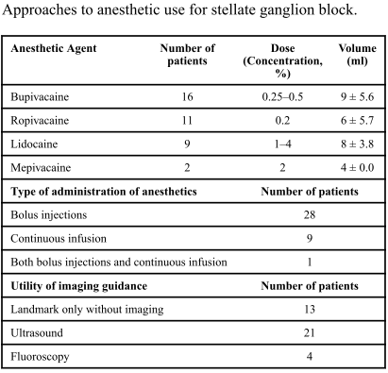
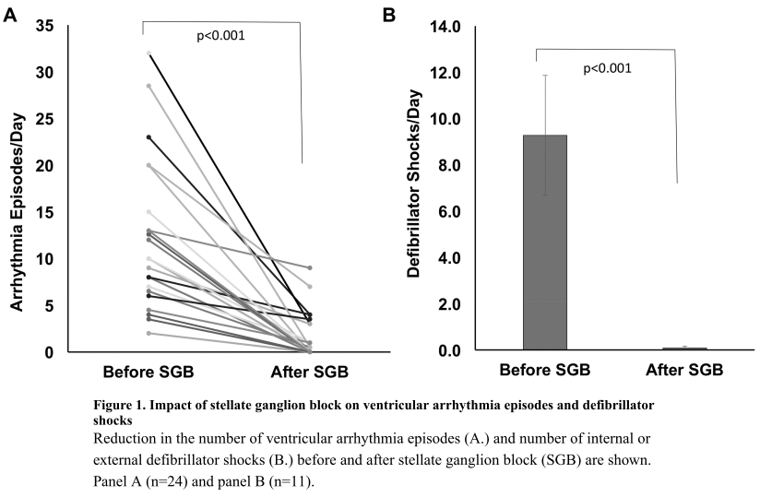
Stellate ganglion blockade
Meta-analysis of Stellate Ganglion Blockade in Managing Electrical Storm
38 patients from 23 studies met study criteria (52 ± 19.1 years, 11 F, 17 with ischemic cardiomyopathy
J Cardiovasc Electrophysiol. 2017;28:1460–1467
KONKUK UNIVERSITY MEDICAL CENTER
JACC Clin Electrophysiol. 2017 September ; 3(9): 942–949.

Slide 8
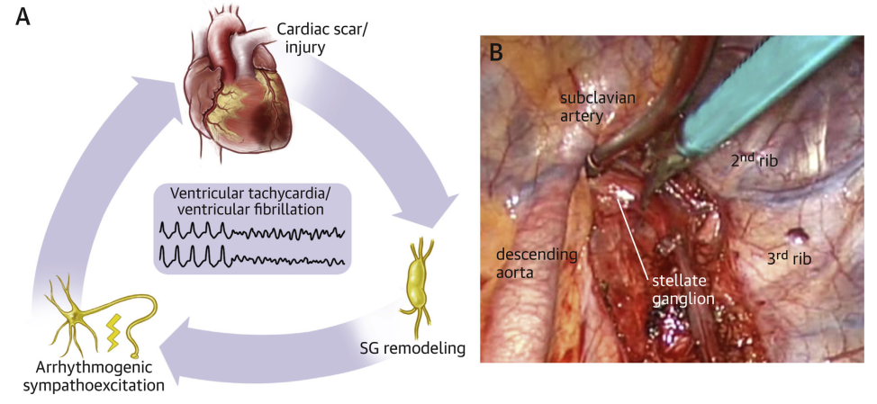
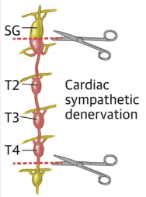
Cardiac sympathetic denervation
removing the bottom one-half of the SG and T2 to T4 ganglia under thoracoscopic guidance
KONKUK UNIVERSITY MEDICAL CENTER
Zhu, C. et al. J Am Coll Cardiol EP. 2019;5(8):881–96
Notes:
(A) Structural heart diseases lead to remodeling of the stellate ganglia (SG), which causes increased sympathetic outﬂow leading to arrhythmias. (B) Cardiac sympathetic
denervation is performed by removing the bottom one-half of the SG and T2 to T4 ganglia under thoracoscopic guidance.

Slide 9
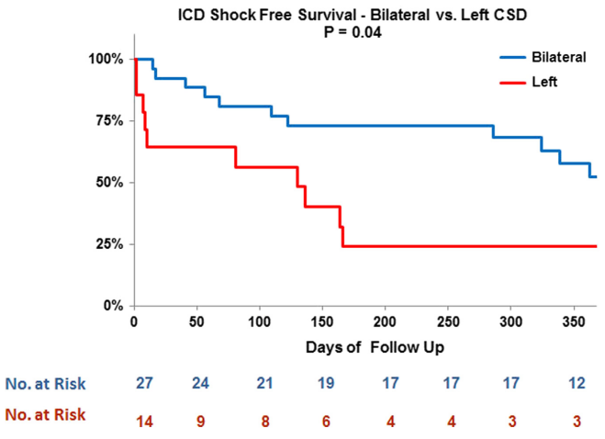
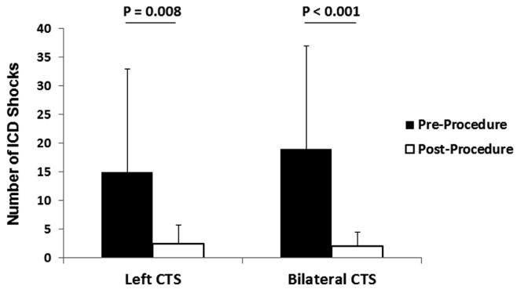
Cardiac sympathetic denervation (Left vs Bilateral)
Forty-one patients underwent CSD (14 left CSD, 27 bilateral CSD)
Burden of ICD shocks pre- and post-procedure
KONKUK UNIVERSITY MEDICAL CENTER
Heart Rhythm 2014;11:360 – 366

Slide 10
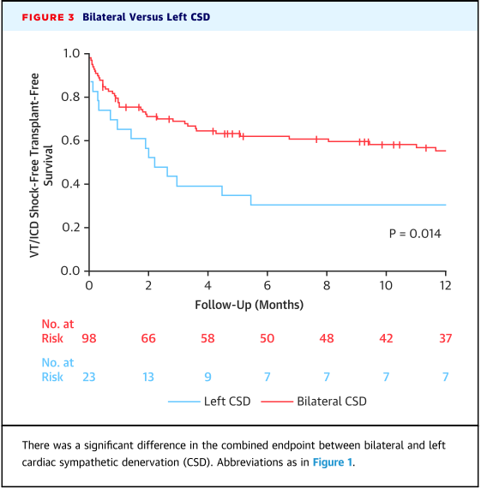
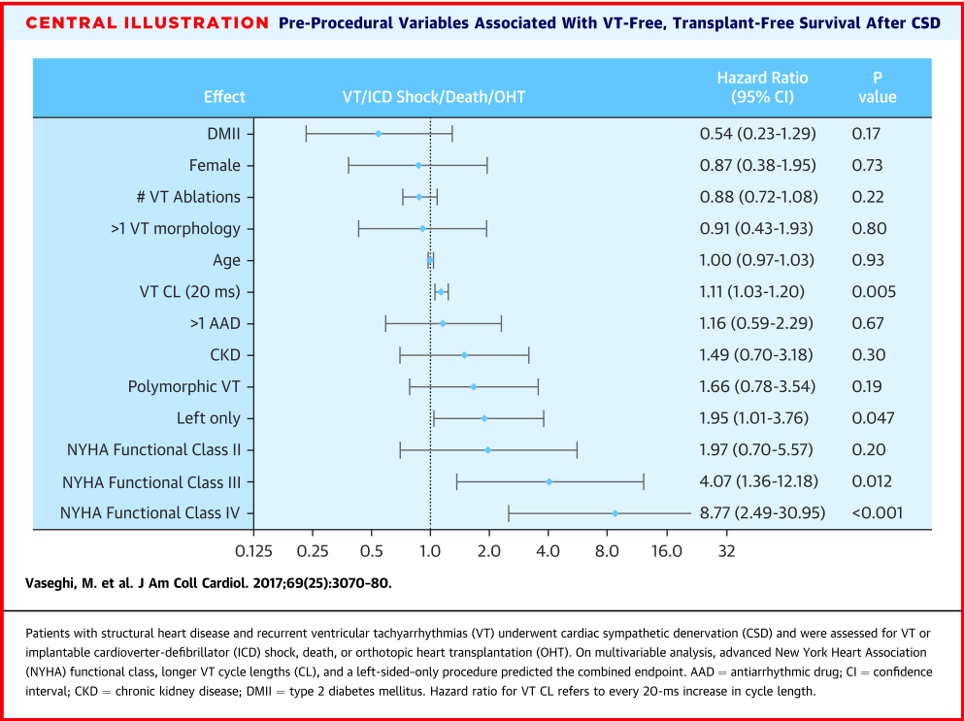
Cardiac sympathetic denervation (Left vs Bilateral)
121 patients (age 55 ± 13 years, 26% female, mean EF of 30 ± 13%) underwent left or bilateral CSD
KONKUK UNIVERSITY MEDICAL CENTER

Slide 11
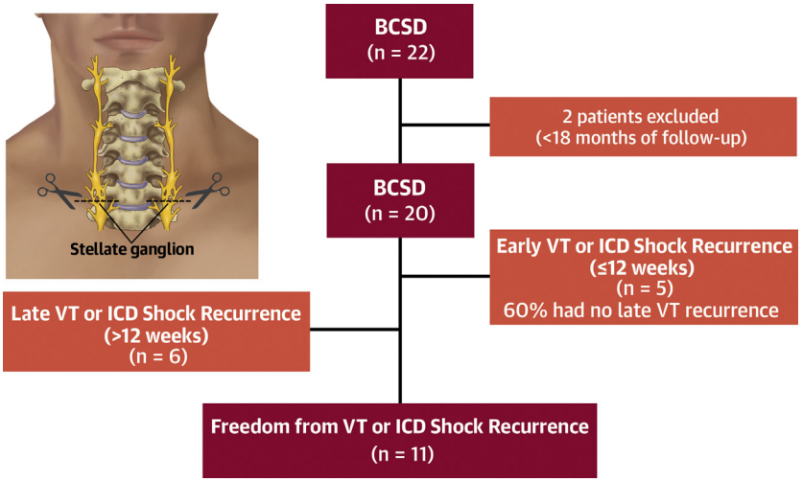
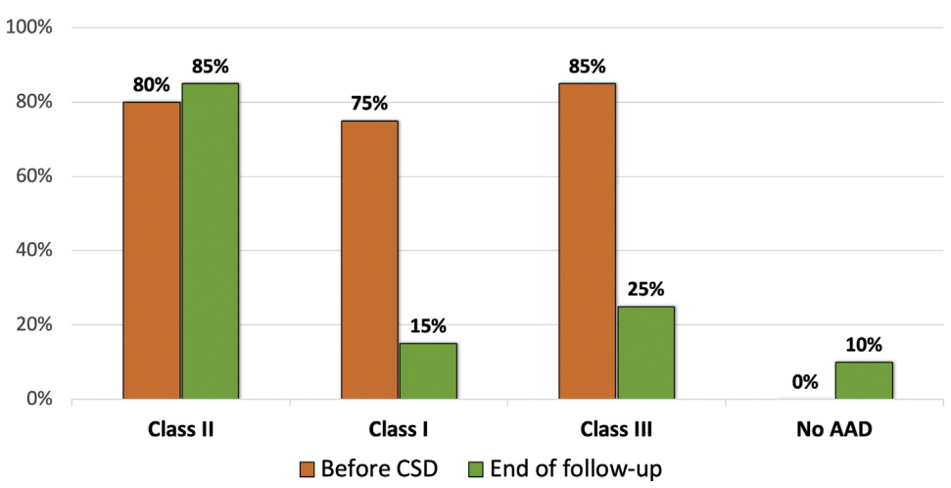
Long-term outcomes of bilateral CSD
Twenty patients (42 ± 16 years; 55% male), over a mean follow-up of 1,300 ± 321 days
Antiarrhythmic Drug Proﬁle Before CSD and at the End of Follow-Up
Freedom from sustained VT or ICD shock was 54.5% (95% CI: 0.31 to 0.73) after BCSD at 4 years.
KONKUK UNIVERSITY MEDICAL CENTER
J Am Coll Cardiol EP 2021;7:463–70

Slide 12
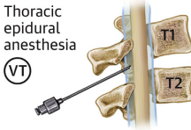
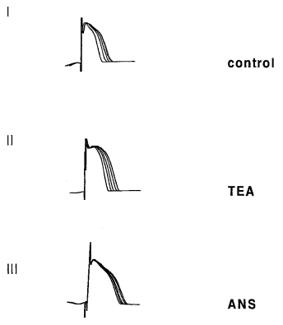
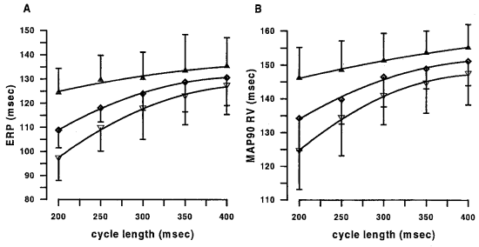
Thoracic epidural anesthesia (TEA)
in vivo canine model
Example of MAP shortening with decreasing cycle length
RV endocardial effective refractory period (ERP; A) and monophasic action potential duration at 90% repolarization (MAP90 RV; B)
TEA (diamond), ANS blockade (triangle), vs control (upside down triangle)
KONKUK UNIVERSITY MEDICAL CENTER
Anesthesiology 2001; 95:132–8

Slide 13
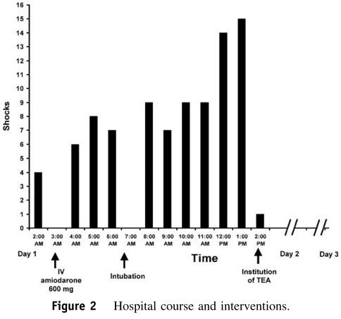
Thoracic epidural anesthesia (TEA)
Case report - a 75-year-old man with a history of ICMP (EF 20%)
Thoracic epidural anesthesia
After sterile skin preparation
Left lateral decubitus position
a 17-gauge Tuohy epidural needle was inserted into the thoracic T1-2 epidural interspace
A 19-gauge Flex-Tip Plus epidural catheter (Arrow International Inc., Reading, PA, USA) was advanced 5 cm beyond the needle tip into the epidural space and sterilely secured.
Proper placement of the epidural catheter was later conﬁrmed using ﬂuoroscopic imaging.
Initially, 1mL of 0.25% bupivacaine was injected epidurally, followed by continuous infusion at 2mL/hour.
KONKUK UNIVERSITY MEDICAL CENTER
Heart Rhythm 2005;2:1359–1362

Slide 14
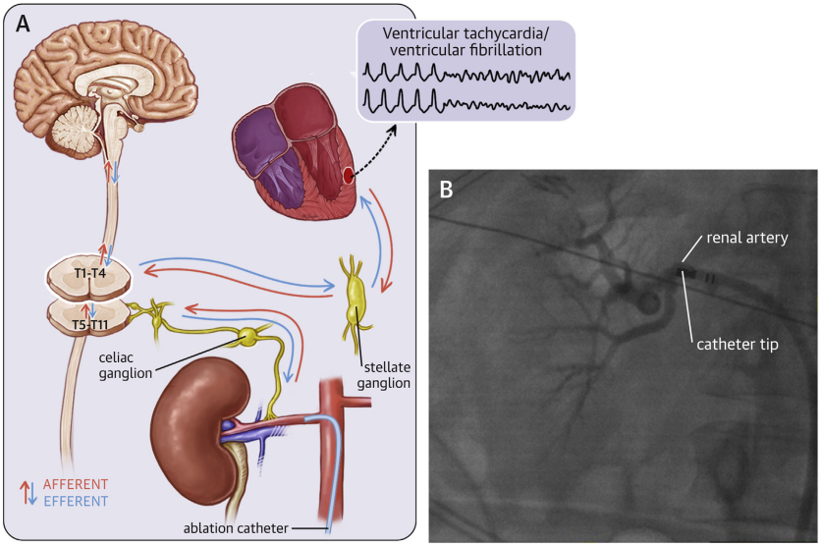
Renal artery denervation (RAD)
(A) Renal artery denervation exerts its antiarrhythmic effect by decreasing renal afferent signals, which in turn decreases efferent sympathetic outﬂow to the heart.
(B) Renal artery denervation is performed via catheter ablation under guidance by contrast angiography.
KONKUK UNIVERSITY MEDICAL CENTER
Zhu, C. et al. J Am Coll Cardiol EP. 2019;5(8):881–96

Slide 15
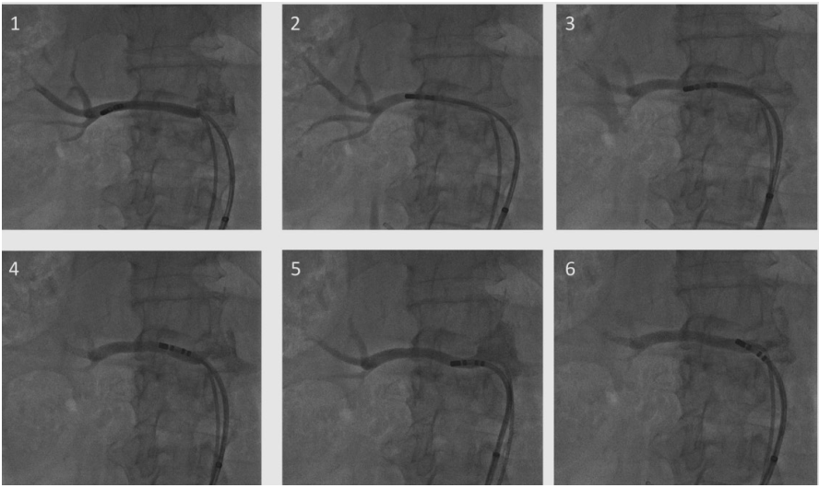
Sequential RF lesions in renal arteries
unfractionated heparin was administered at a dose of 100 U/kg.
Aortography at the level of the renal arteries was performed after administration of intravenous NTG (200 mg), followed by catheterization and selective renal arteriography for the evaluation of the anatomy.
At least 4 radiofrequency lesions were delivered along both renal arteries, starting from the distal segments toward the ostia.
The catheter was pulled 5 mm and was rotated after each radiofrequency delivery, thus producing a spiral conﬁguration of the ablations.
analgesia with fentanyl and morphine was performed
RF energy - 12 W for 30 seconds at a ﬂow rate of 17 cm³/min.
KONKUK UNIVERSITY MEDICAL CENTER
Arq Bras Cardiol. 2014; 102(4):355-363

Slide 16
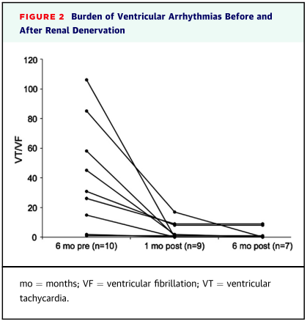
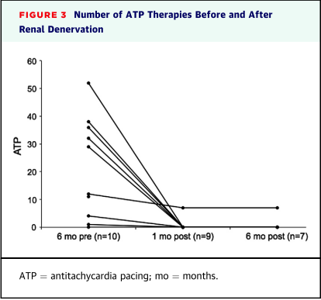
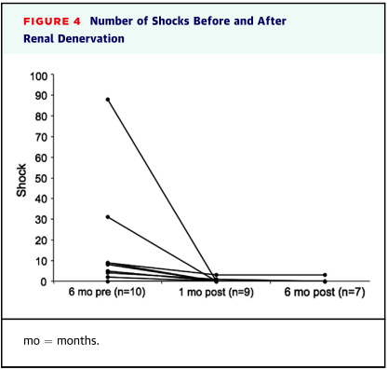
RAD for the treatment of refractory VA
A total of 10 patients with refractory VA underwent RAD
KONKUK UNIVERSITY MEDICAL CENTER
J Am Coll Cardiol Intv 2015;8:984–90

Slide 17
RAD + CA in the treatment of VA
A total of 32 patients with ICDs who underwent CA or both CA and RSDN for refractory VAs
Patients were followed up at a median of 15 months (6 to20 months)
KONKUK UNIVERSITY MEDICAL CENTER
Am J Cardiol 2016;118:1207- 210

Slide 18
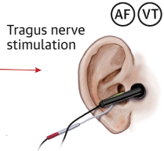
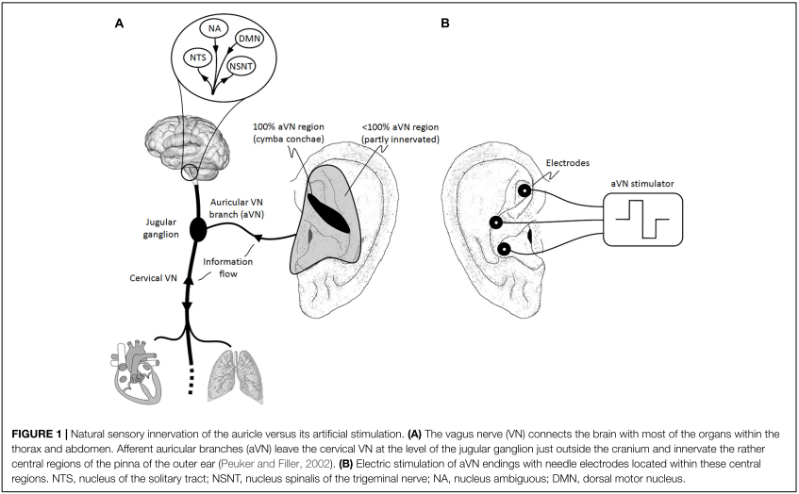
Tragus nerve stimulation (TNS)
KONKUK UNIVERSITY MEDICAL CENTER
Front. Neurosci. 13:772

Slide 19
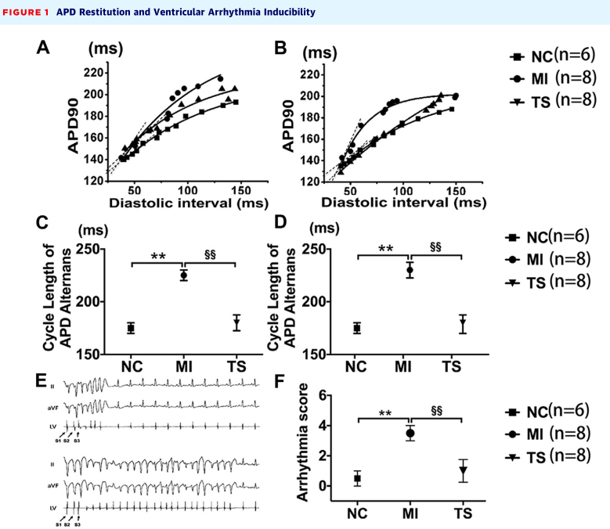
Tragus nerve stimulation (TNS)
in a post-infarction canine model
normal control (n = 6), MI (LAD ligation without LL-TS [n = 8]), and TS (MI plus LL-TS [n = 8]) groups.
LL-TS was delivered 2 h each day at 80% below the threshold which slowed sinus rate
(A to D) Examples of dynamic APD restitution curves at remote (A and C) and peri-infarcted (B and D) zones.
(E) Programmed ventricular stimulation-induced ventricular arrhythmias
(F) arrhythmia scores.
KONKUK UNIVERSITY MEDICAL CENTER
J Am Coll Cardiol EP 2016;2:330–9

Slide 20
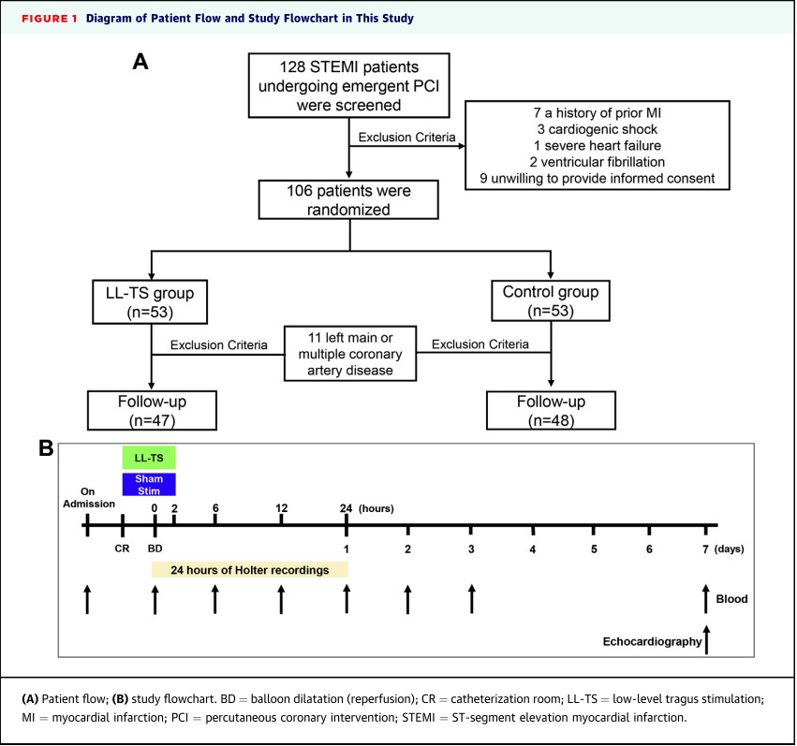
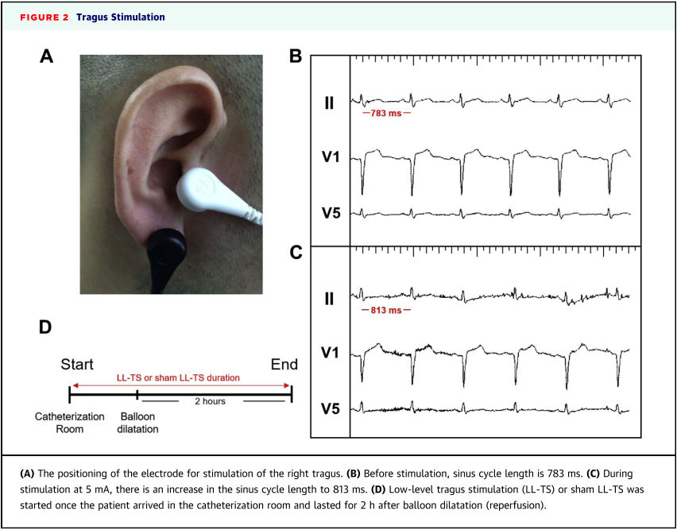
Low-level TNS in patients with STEMI
The lowest electric current necessary to slow the sinus rate was deﬁned as the stimulation threshold.
LL-TS was set at 50% below the threshold with a duty cycle of 5s on and 5s off.
KONKUK UNIVERSITY MEDICAL CENTER
J Am Coll Cardiol Intv 2017;10:1511–20

Slide 21
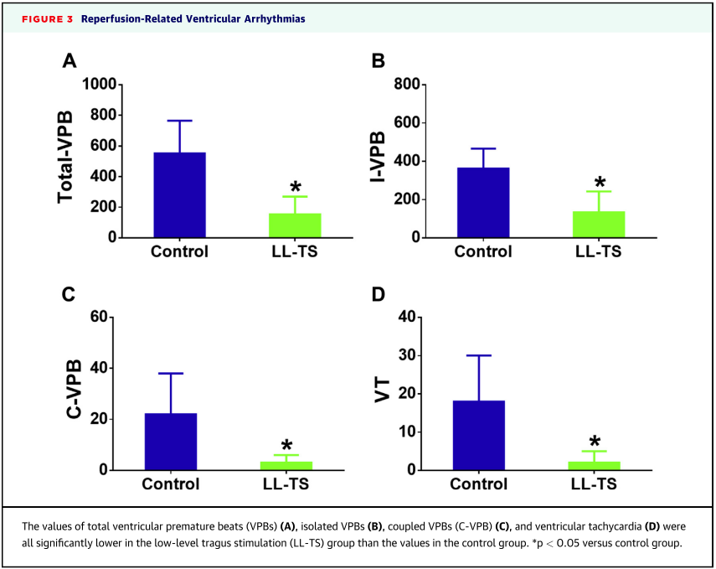
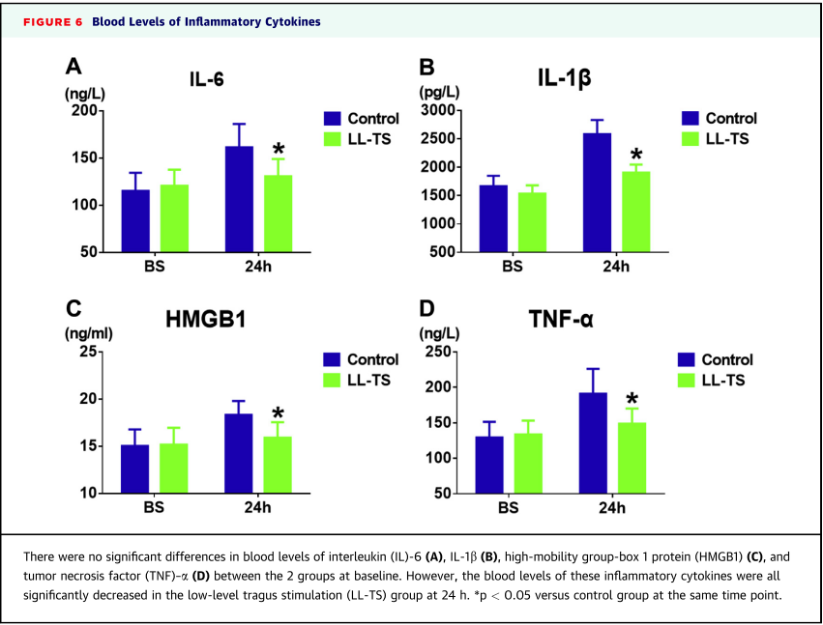
Low-level TNS in patients with STEMI
LL-TS signiﬁcantly improves inﬂammatory responses, reperfusion-related VAs
KONKUK UNIVERSITY MEDICAL CENTER
J Am Coll Cardiol Intv 2017;10:1511–20

Slide 22
Summary
Signiﬁcant progress has been made in developing neuromodulatory techniques for heart rhythm disorders
LCSD continues to improve outcomes for those with LQTS and CPVT
BCSD is now becoming more widely used for its effectiveness in refractory VT/VF cases, especially in patients with SHD
Modulation at the spinal cord, vagus, SG, and ICNS, as well as distant renal sympathetic nerves can reduce ventricular arrhythmias

Slide 23
감사합니다
Thank you!

